Slide 1

HOME FINDER CMPE-202-02
Team 5
Application URL: https://homefinder-frontend.herokuapp.com/

Slide 2
Team Members
Aditya Shah - 008799297
Deepthi Jallepalli - 014489241
Prashanth Narasimha - 014632592
Prerana Shekhar - 013800696

Slide 3





Tools and Technologies
FRONTEND
ReactJS
React Bootstrap
HTML
CSS
BACKEND
Django
PostgreSQL
Algolia Search DB
Postman
COLLABORATION
GitHub
Kanban
DESIGN
Lucid Charts
Pencil Project
DEPLOYMENT (CI/CD)
Heroku
Github actions

Slide 4
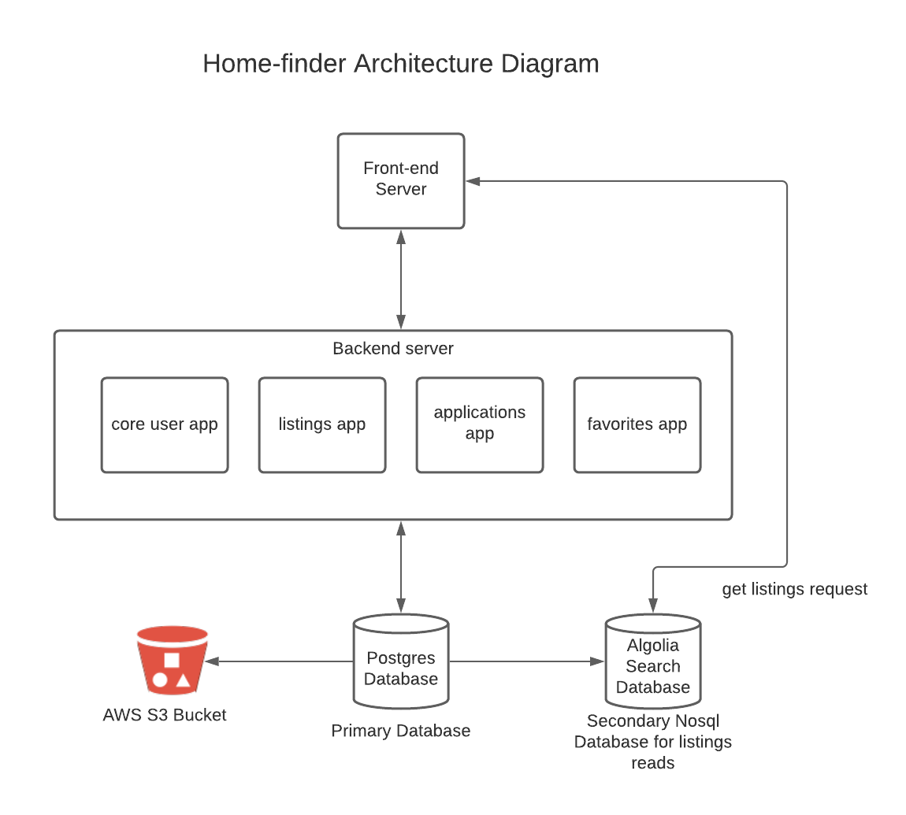
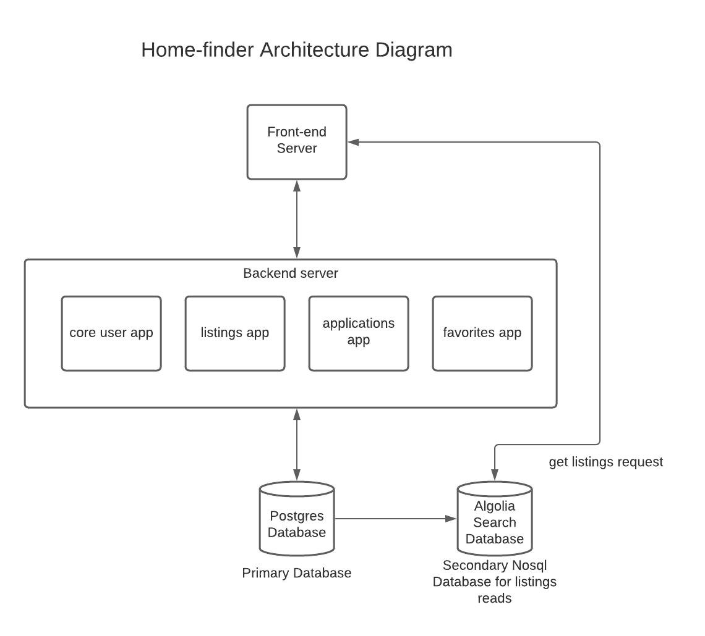
Architecture Diagram
- CQRS Architecture – separates read and write
- Algolia Database - Nosql
- Increased efficiency
- Faceted search
- Primary Database – Postgres (SQL)
- Deployment - Heroku
- Django Model and Views design patterns

Slide 5
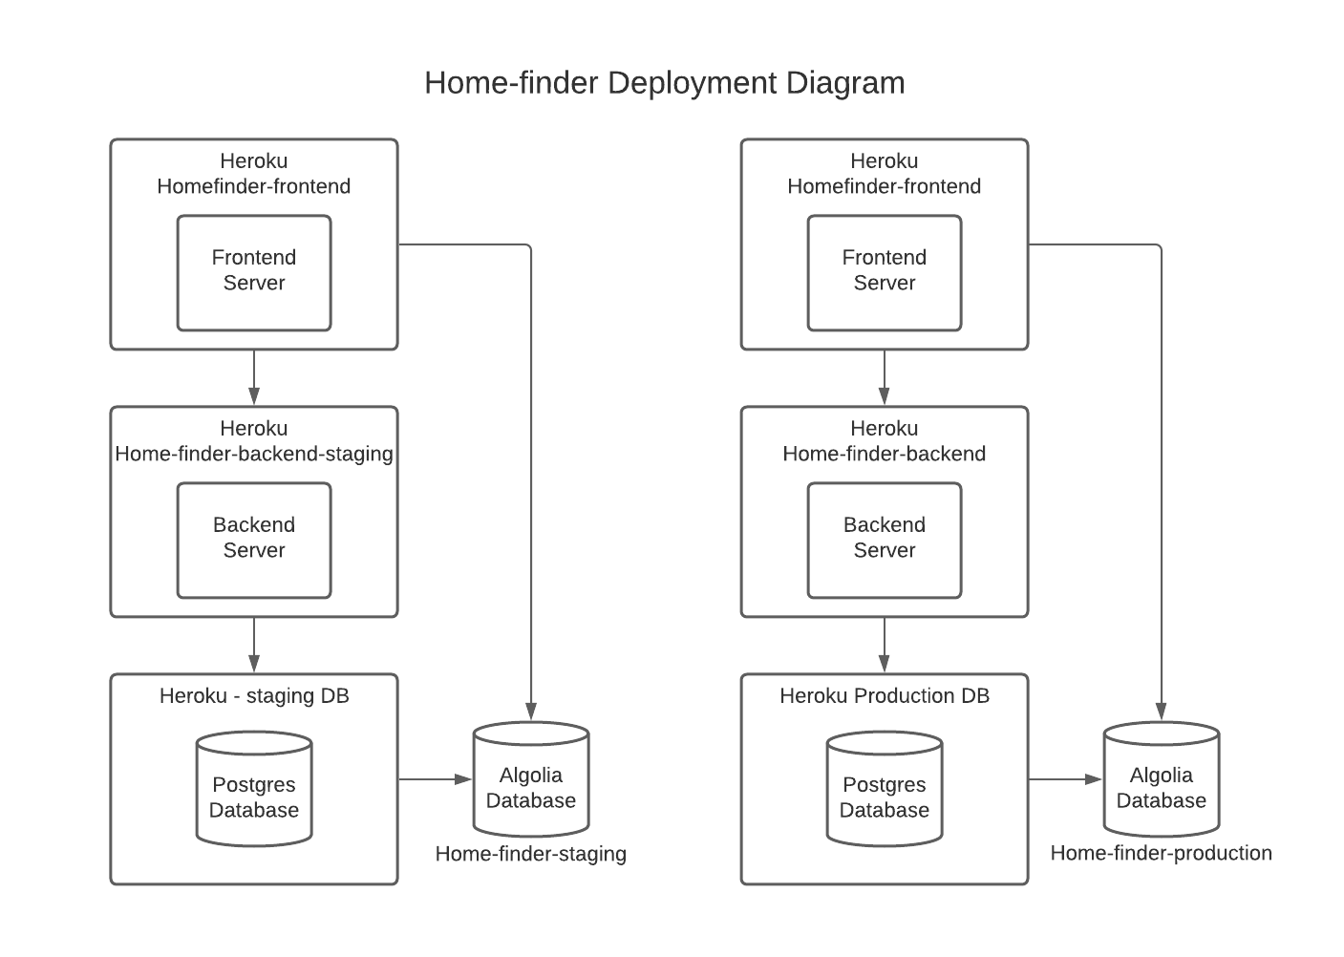
Deployment Diagram
Environments
- Staging
- Production
- CI/CD

Slide 6
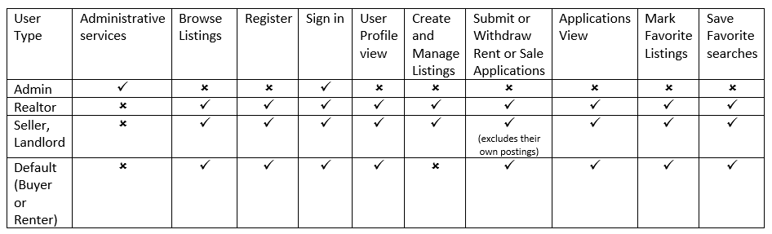
Architecture, Application Design and Business-level
Browsing and searching listings
User Status
Approved, Pending, Rejected, Deactivated
By default all registered user are assigned pending status
Login
Users need to login to use all other services except searching and browsing.
Only approved users can login
A removed user can not register or login
Listing
Once a buyer application is approved, the property is marked as Sold
My Listings feature is only available for Realtor, Seller and Landlord
Seller or Realtor or Landlord can create and manage multiple listings
Buy and Sell listings view
Email notifications - registration, schedules, application
Design Decisions

Slide 7
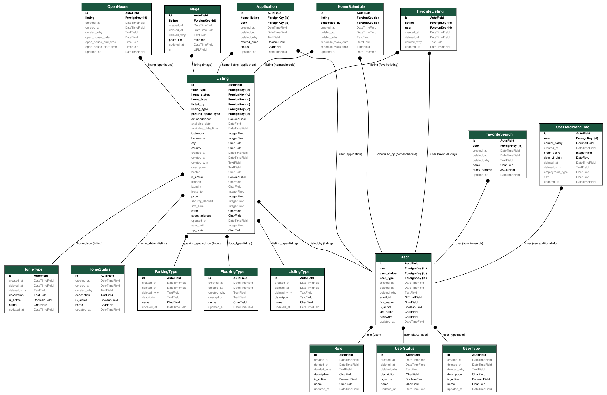
Database
Design

Slide 8
XP Core Values
Communication
Feedback
Respect
Simplicity
Scrum call
Slack
Github Projects
Kanban Board
Work breakdown
Pull requests
Code approval
Missing features
Testing
Accepting new ideas
Availability
Focus on needs
Heroku CI/CD deployment

Slide 9
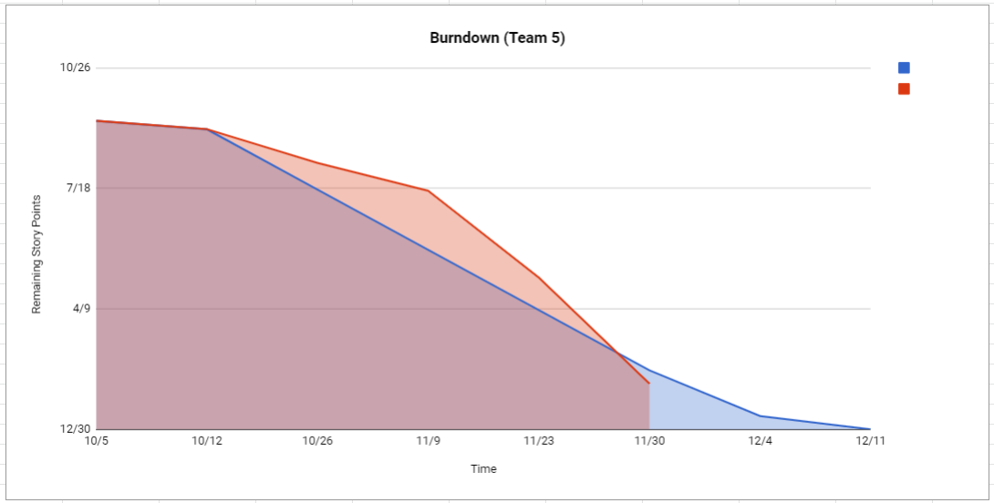
Agile
Weekly scrum calls
status, to-do, any bottlenecks
Sprint planning
Story Point Estimation: 1,2,3,5
Scrum board
Github projects automation Kanban board
Wiki pages to track scrum call MOM
Retrospection
Followed all stages of SDLC
throughout the sprints

Slide 10
Individual Contributions
Aditya (Frontend)
Buy, Sell, Listings view
Deployment - Heroku
Create/Edit Listings
Schedule Visits
Open house Schedule
Deepthi (Backend)
Database design
User authentication using JWT tokens
User – register, login, profile
Admin - retrieve, approve, reject and remove users
Email notification utility implementation
Applications – retrieve, submit, update, withdraw, approve, reject
Prashanth (Frontend)
Admin - retrieve, approve, reject and remove users
User – register, login, profile
Listings filter
Applications
Favorites – fav search, fav listings
Prerana (Backend)
Favorites - fav search, fav listings, create, update, delete
Deployment - Heroku, CI/CD
Algolia database - Sync with primary DB, Postgres
Architecture Design
Listings – view, create, update, delete
Schedule – open house, visits, email
notification

Slide 11
Thank you

